Slide 1
By JAMIE MERISOTIS | July 30, 2021

Slide 2

The work of the
future is Human Work
01

Slide 3
TECHNOLOGY:
Can take over more
and more tasks that
people used to do.
More jobs consist of
tasks that require human
traits and abilities.
People must develop
their traits and abilities
for human work.
02

Slide 4
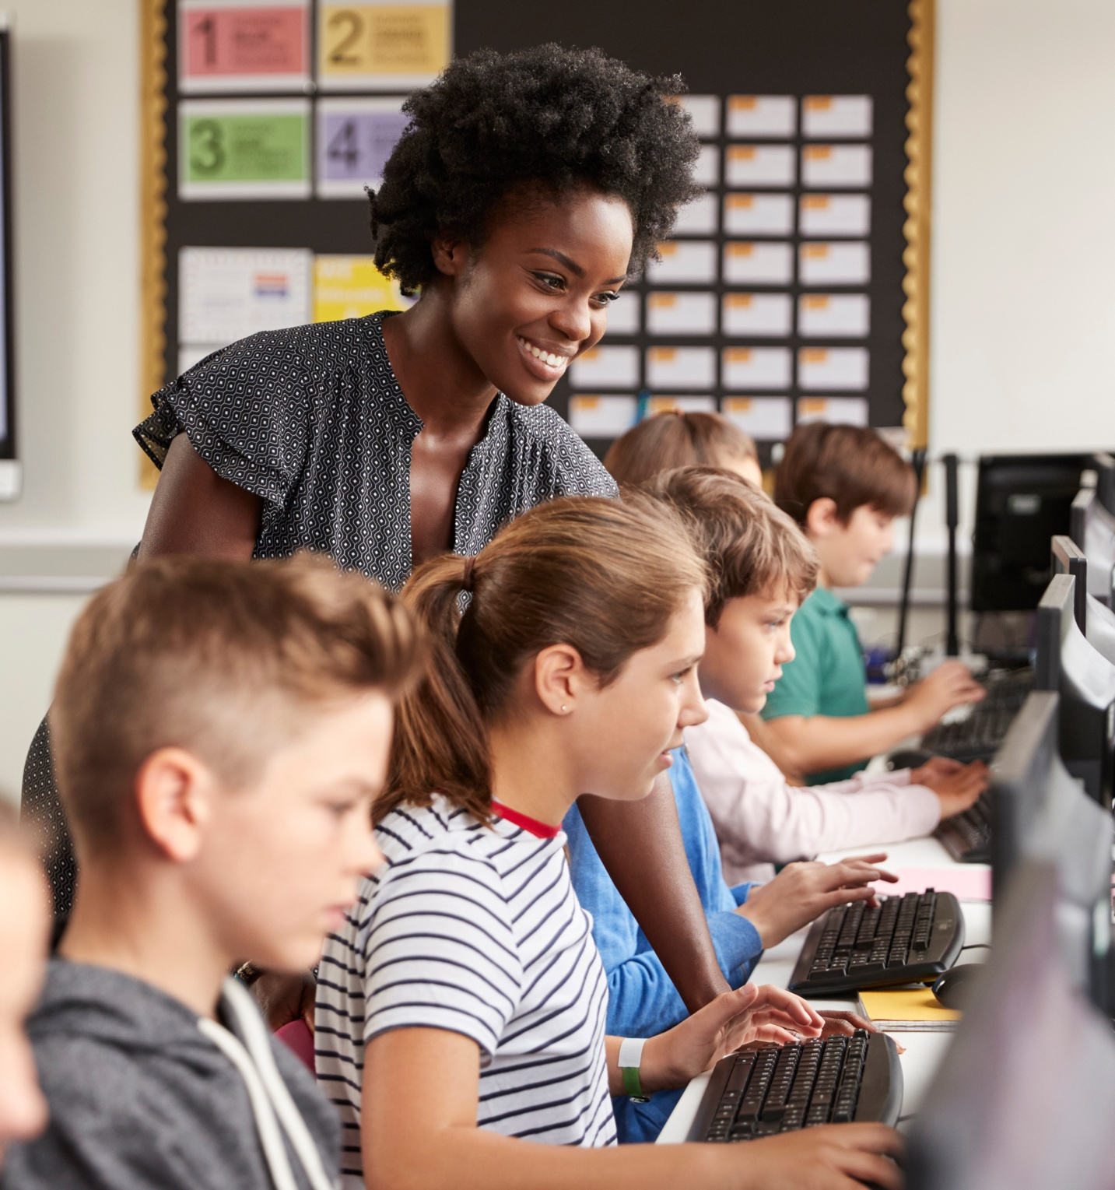
THE WORK ONLY HUMANS
CAN DO
The essential abilities for human work:
Think critically
Reason ethically
Collaborate and interact personally
Serve others with empathy
03

Slide 5

WORK MATTERS
Work matters for reasons beyond the purely economic
Work offers social mobility,
personal satisfaction, and a
range of other rewards too
numerous to list.
People need an income to live and
support their families, but work offers
something even more important —
meaning and a sense of purpose.
04

Slide 6
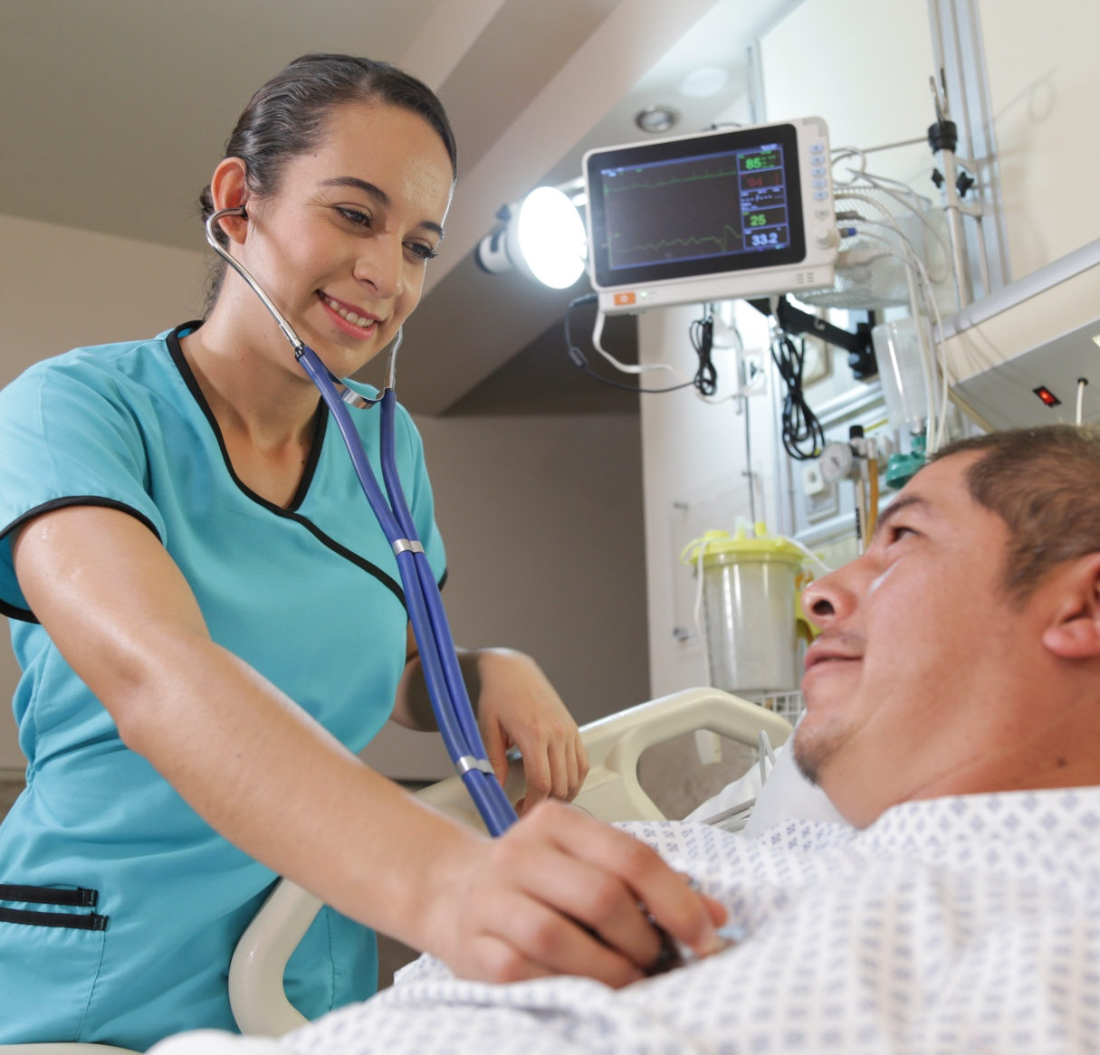
PREPARING FOR
HUMAN WORK
Human work requires wide learning
in terms of time, people, and content.
The essential skills for human work:
People
Skills
Problem
Solving
Integrative
Skills
05

Slide 7
NEW OCCUPATIONS
FOR HUMAN WORK
Helpers
Integrators
Bridgers
Creators
06

Slide 8
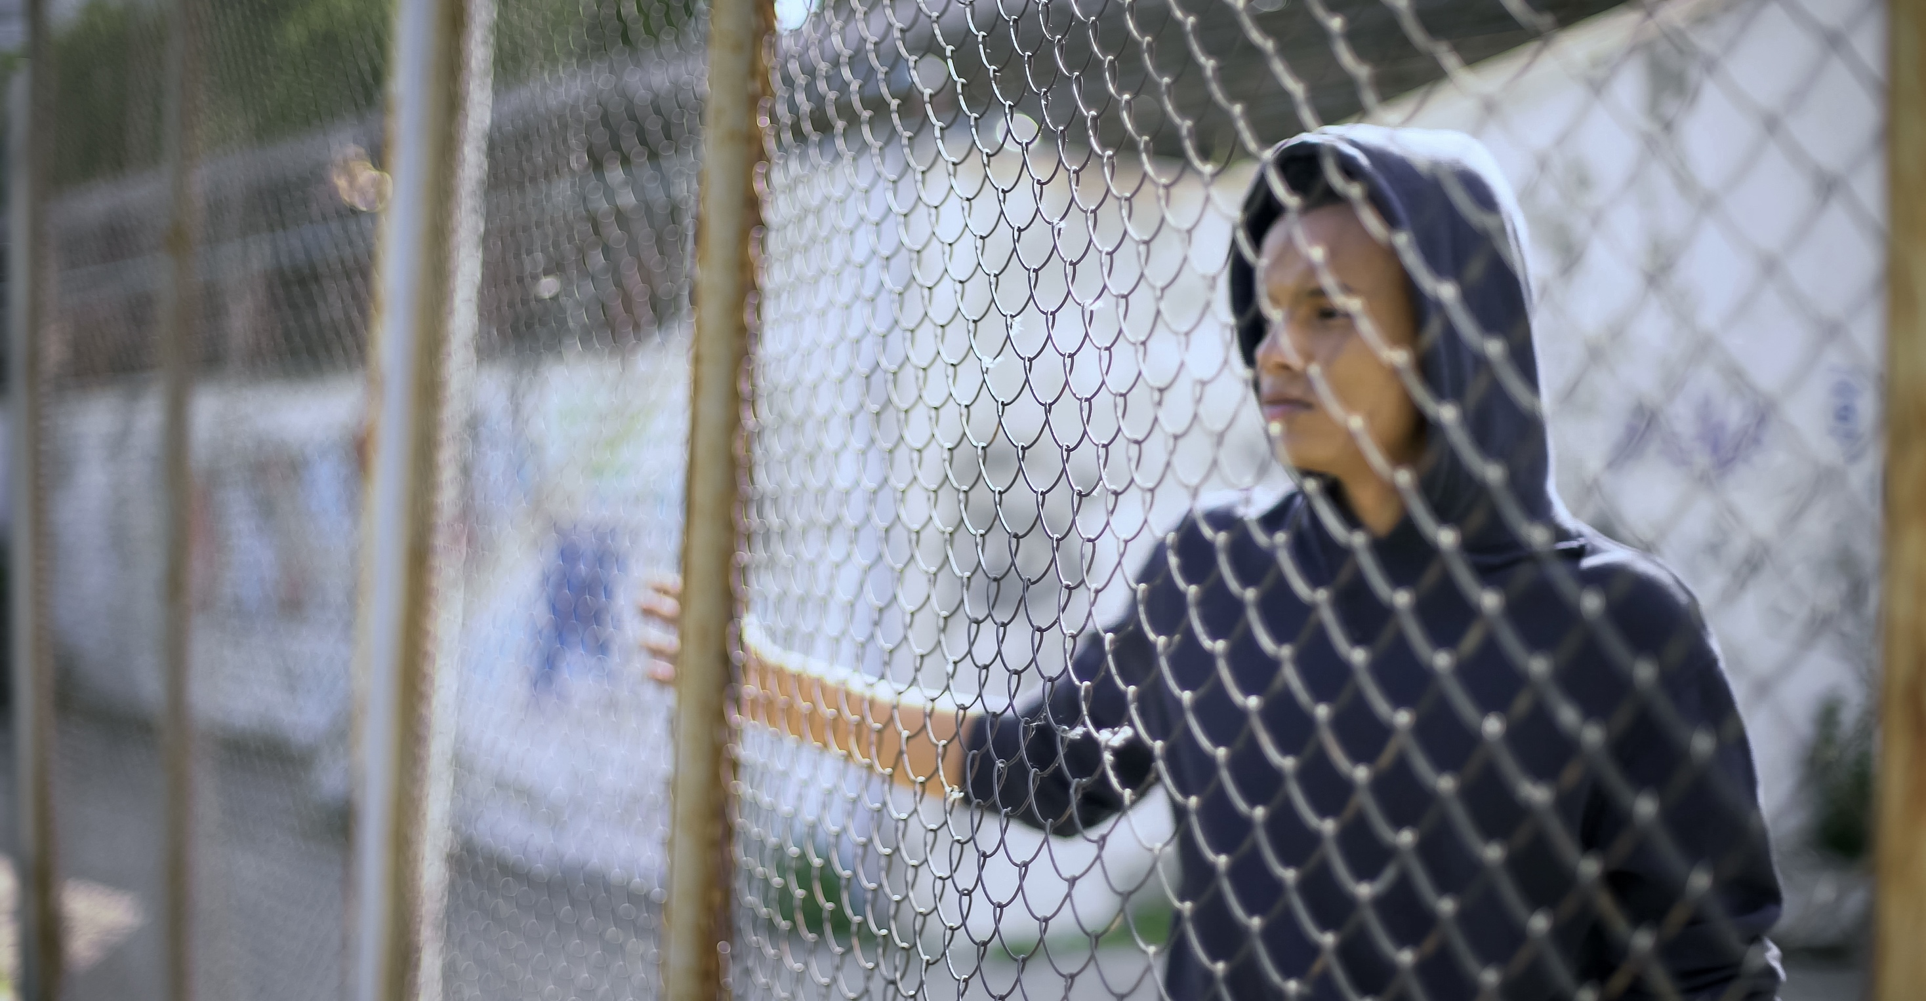
The lack of talent
for human work is a
growing global problem
07

Slide 9

EDUCATING FOR HUMAN WORK
More people need higher-level learning for human work.
New learning systems will be built around flexible pathways through life and careers.
08

Slide 10
Problem 1: It’s not clear what most credentials represent in terms of knowledge, skills, and abilities.
Problem 2: Employers, educators, and
individuals all speak different languages when
it comes to knowledge, skills, and abilities.
CREDENTIALS
FOR HUMAN WORK
Problem 3: Pathways through education
and careers are either nonexistent or
nearly impossible for outsiders to fathom.
09

Slide 11

LEARNING,
EARNING,
SERVING
Work and learning have merged
into a virtuous cycle in which each supports and enhances the other.
10

Slide 12
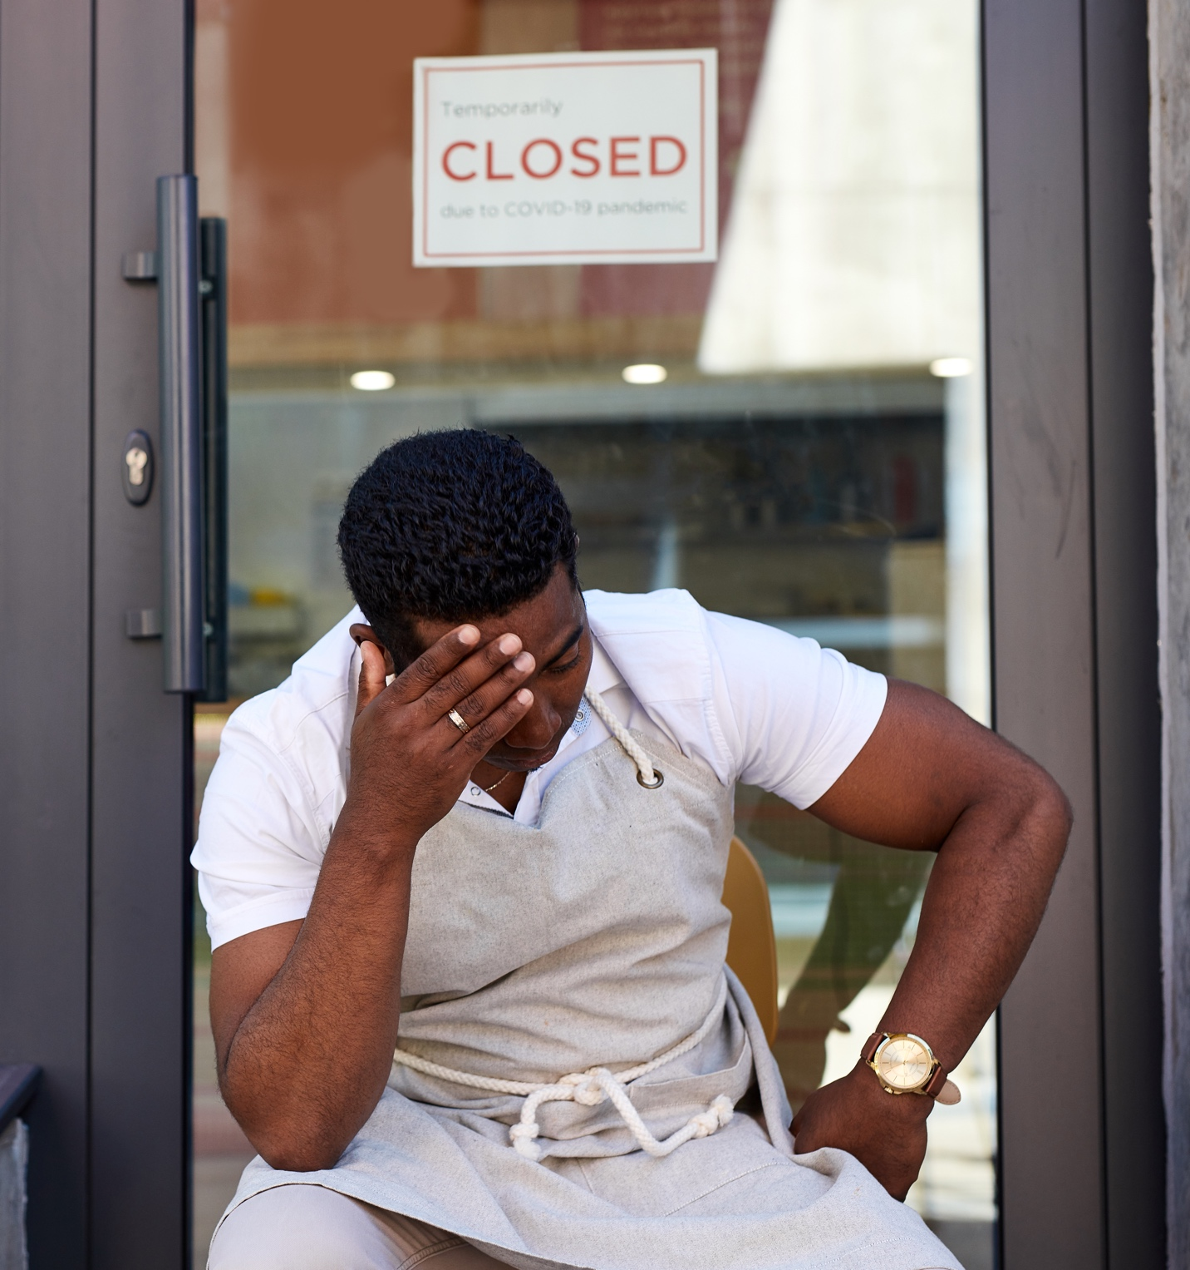
HUMAN WORK
CAN HELP REPAIR
THE SOCIAL FABRIC
When people lose the opportunity to work,
they can feel left behind and left out–
disconnected from their communities
and the broader life of the nation.
Alienation and inequality are threats to democracy and fuel authoritarianism.
Human work helps make people active and engages citizens.
Serving others is integral to human work.
11

Slide 13
EVERYONE HAS
A ROLE TO PLAY
Employers
Educators
Policymakers
Foundations
Workers
12

Slide 14
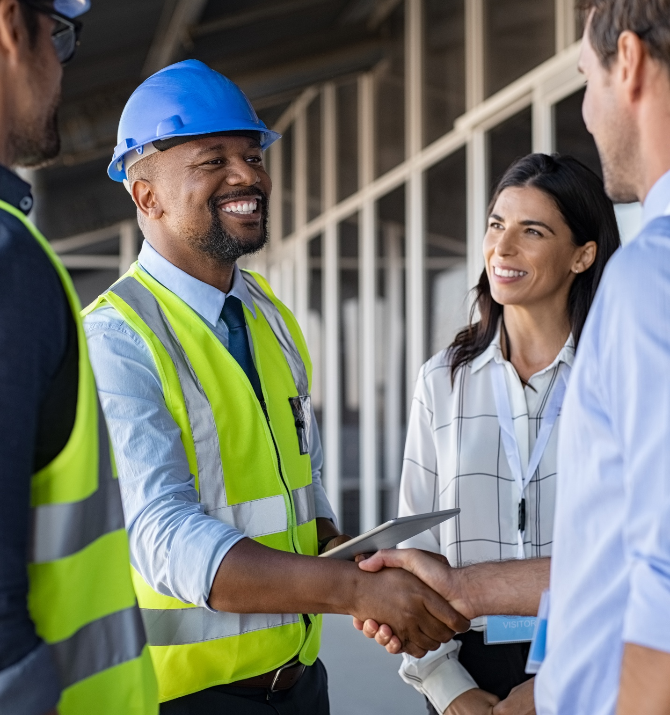
HUMAN WORK IN A DEMOCRATIC
SOCIETY
Happy at
Work image
(job with people)
Work is essential to the social fabric because work brings meaning to people’s lives.
13

Slide 15
Thank you!
@jamiemerisotis
Jamie Merisotis
14

